Slide 1
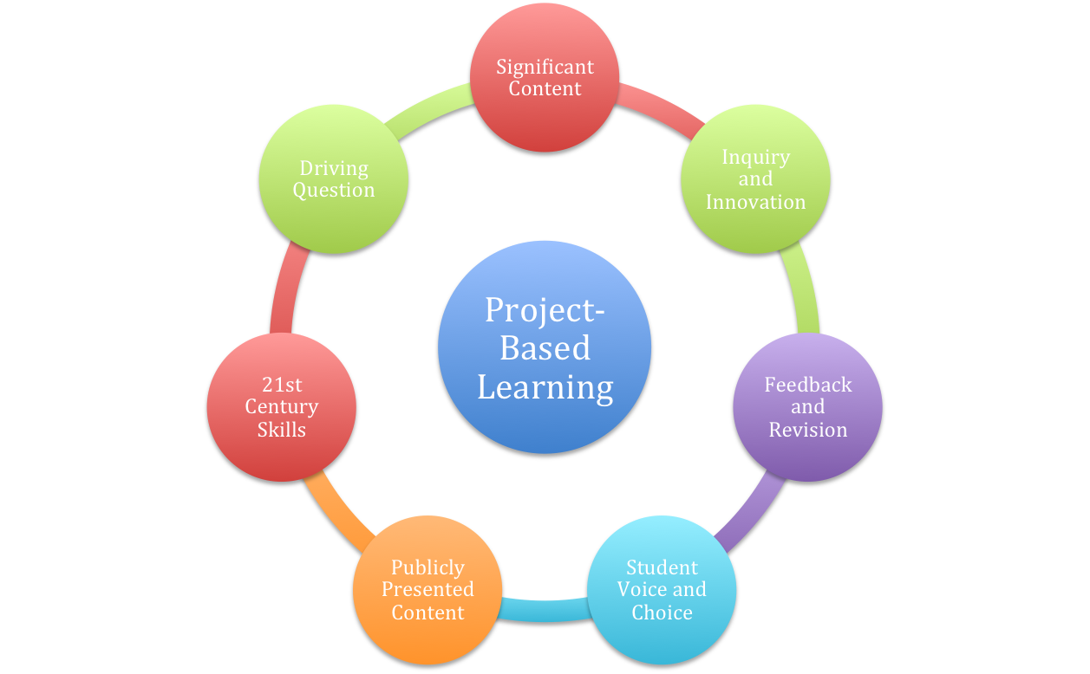
Assessing PBL Using Digital Tools
Stacey Pasquel, M.Ed.
Technology Infusion Specialist
Mary Lou Fulton Teachers College | Arizona State University

Slide 2
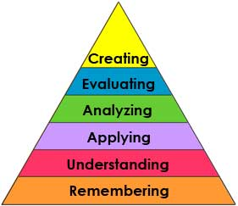
21st Century Learning & Assessment
Self-Directed
Divergent Thinking
Depth of Knowledge
Hands-On
Performance Based
Differentiated
Multiple Resources
Authentic & Relevant
Bloom’s Revised Taxonomy

Slide 3
Top Ten Tips for Assessing Project-Based Learning by Edutopia
PLAN AHEAD
1. Keep It Real with Authentic Products
2. Don’t Overlook Soft Skills
3. Learn from Big Thinkers
LAUNCH INTO LEARNING
4. Use Formative Strategies to Keep Projects on Track
5. Gather Feedback— Fast
6. Focus on Teamwork
7. Track Progress with Digital Tools
SHARE WHAT STUDENTS KNOW
8. Grow Your Audience
REFLECT, REVISE, REVISIT
9. Do-It-Yourself Professional Development
10. Assess Better Together

Slide 4
Tip #4: Use Formative Strategies to Keep Projects on Track
“Formative assessment keeps projects on track while ensuring that diverse learners master important content.”
“In an Edutopia blog post, ‘Assessment Carnival: More Than Quizzes and Tests’, teacher and author Shawn Cornally describes his evolving thinking about assessment. He’s been on a quest to rethink assessment as a tool ‘to create learning, instead of just to judge it’.”
-Top Ten Tips for Assessing Project-Based Learning from Edutopia

Slide 5
Using Digital Assessment Tools to Check Progress & Understanding
Poll Everywhere
Kahoot
Socrative
Plickers

Slide 6
Poll Everywhere www.polleverywhere.com
Ask your audience questions
Audience answers in real time with mobile devices, web browsers or Twitter
See your responses live on the web or in a PPT presentation!

Slide 7
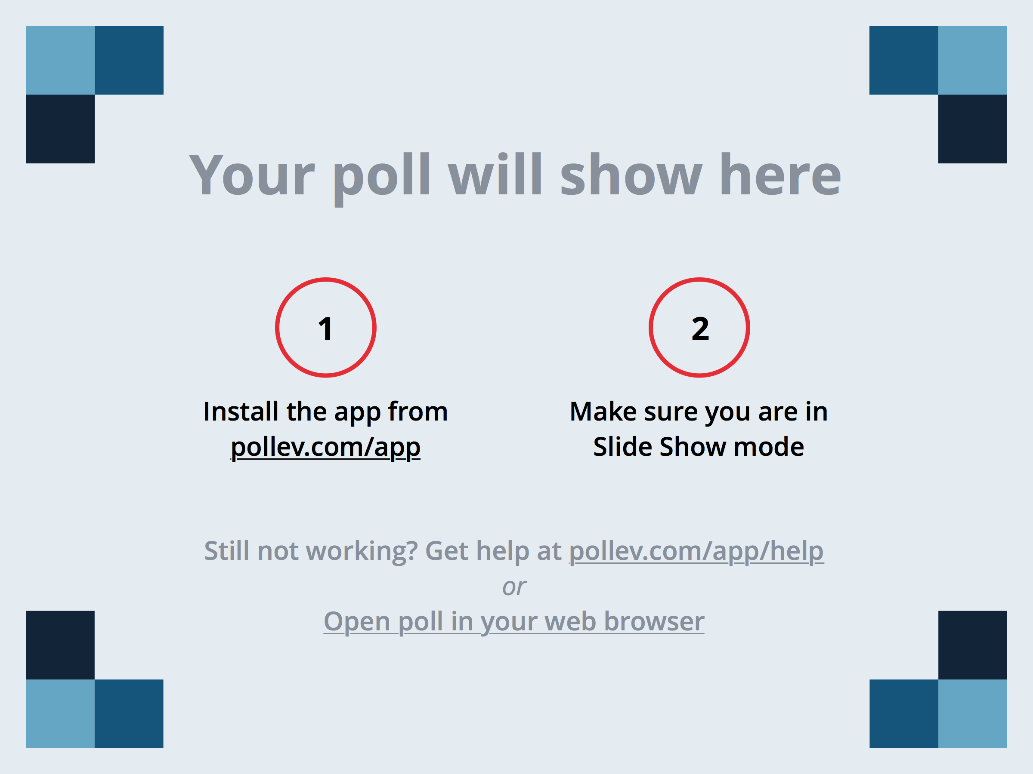
Notes:
Where step are you on in the digital story project timeline? https://www.polleverywhere.com/multiple_choice_polls/cgLjMKw3dh6ohMM

Slide 8
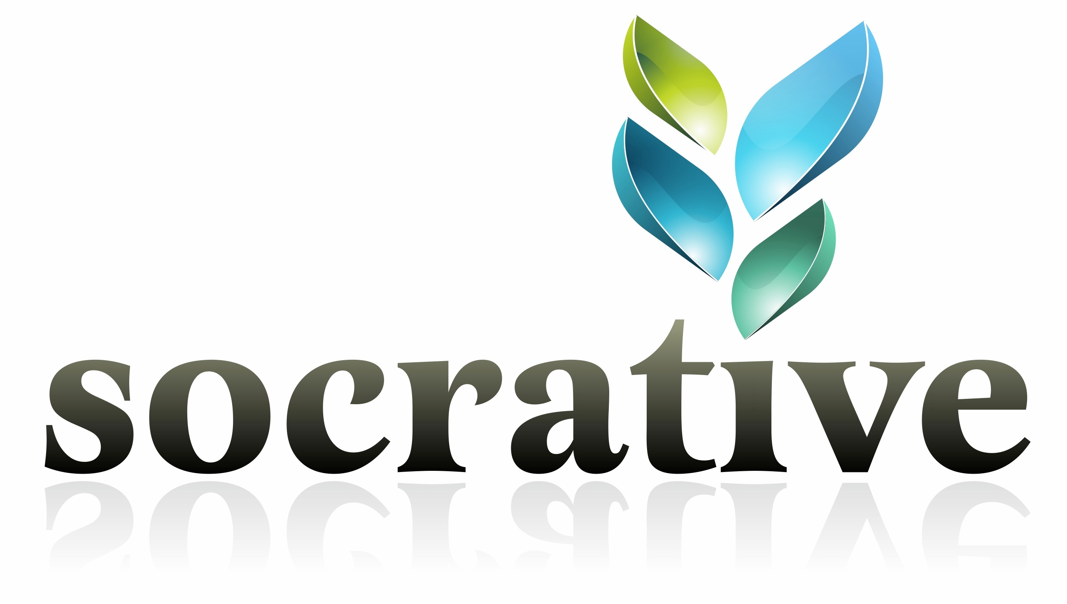
Socrative www.socrative.com
Socrative is a smart student response system that empowers teachers by engaging their classrooms with a series of educational exercises and games. Our apps are super simple and take seconds to login. Socrative runs on tablets, smartphones, and laptops.

Slide 9
Socrative

Slide 10
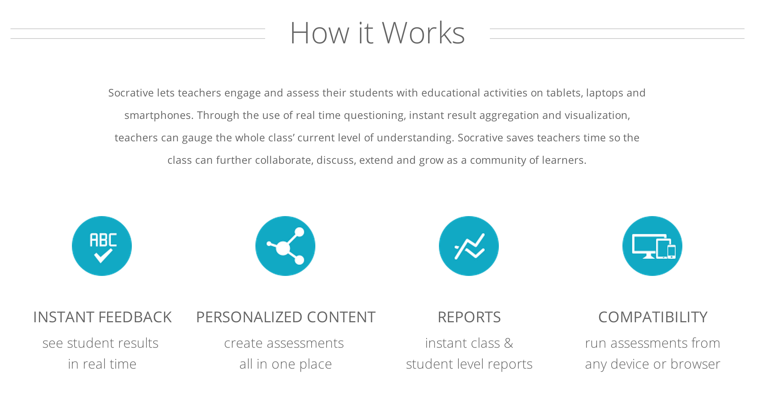
Socrative
Video Overview

Slide 11
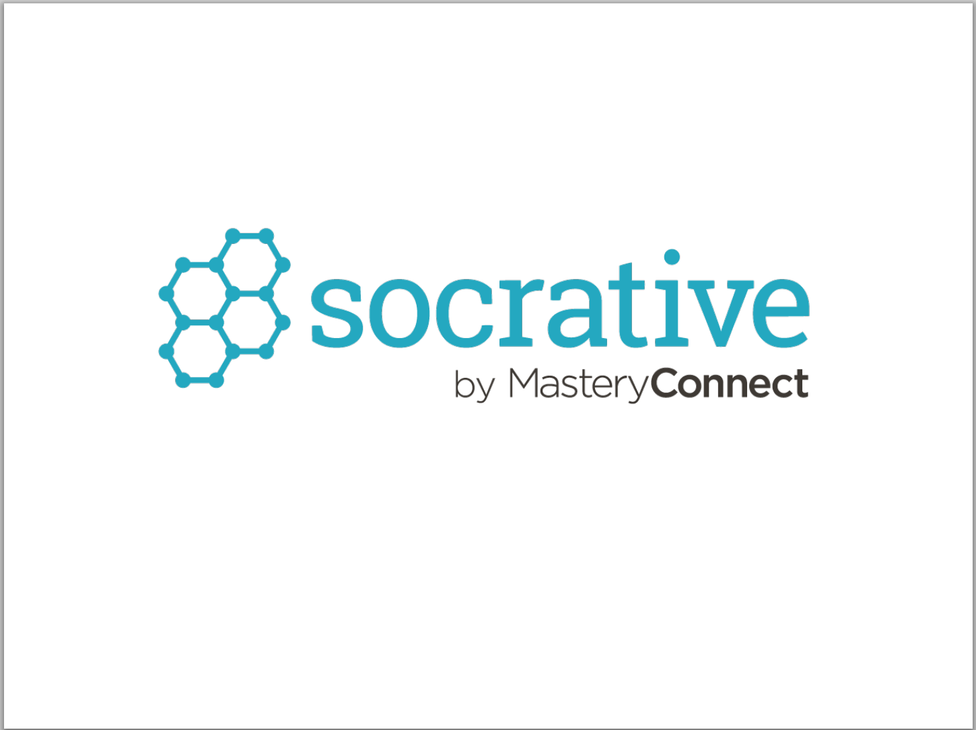
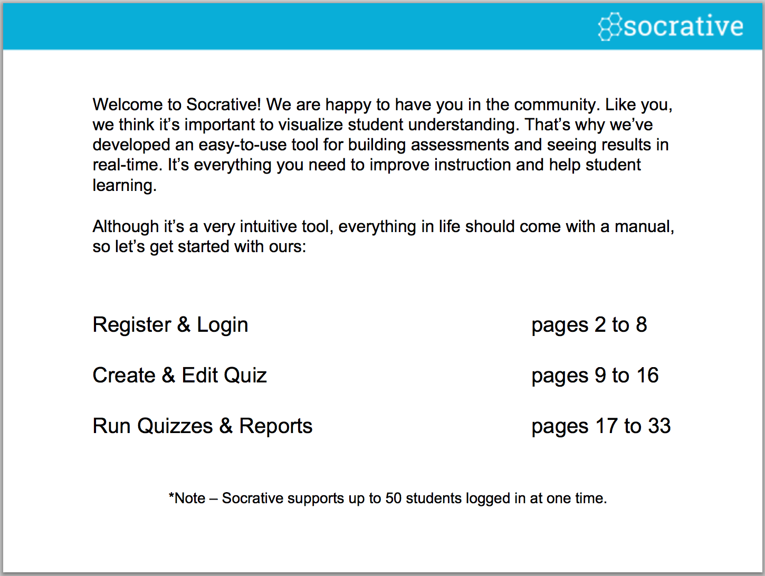
Socrative User Guide http://www.socrative.com/materials/SocrativeUserGuide.pdf

Slide 12
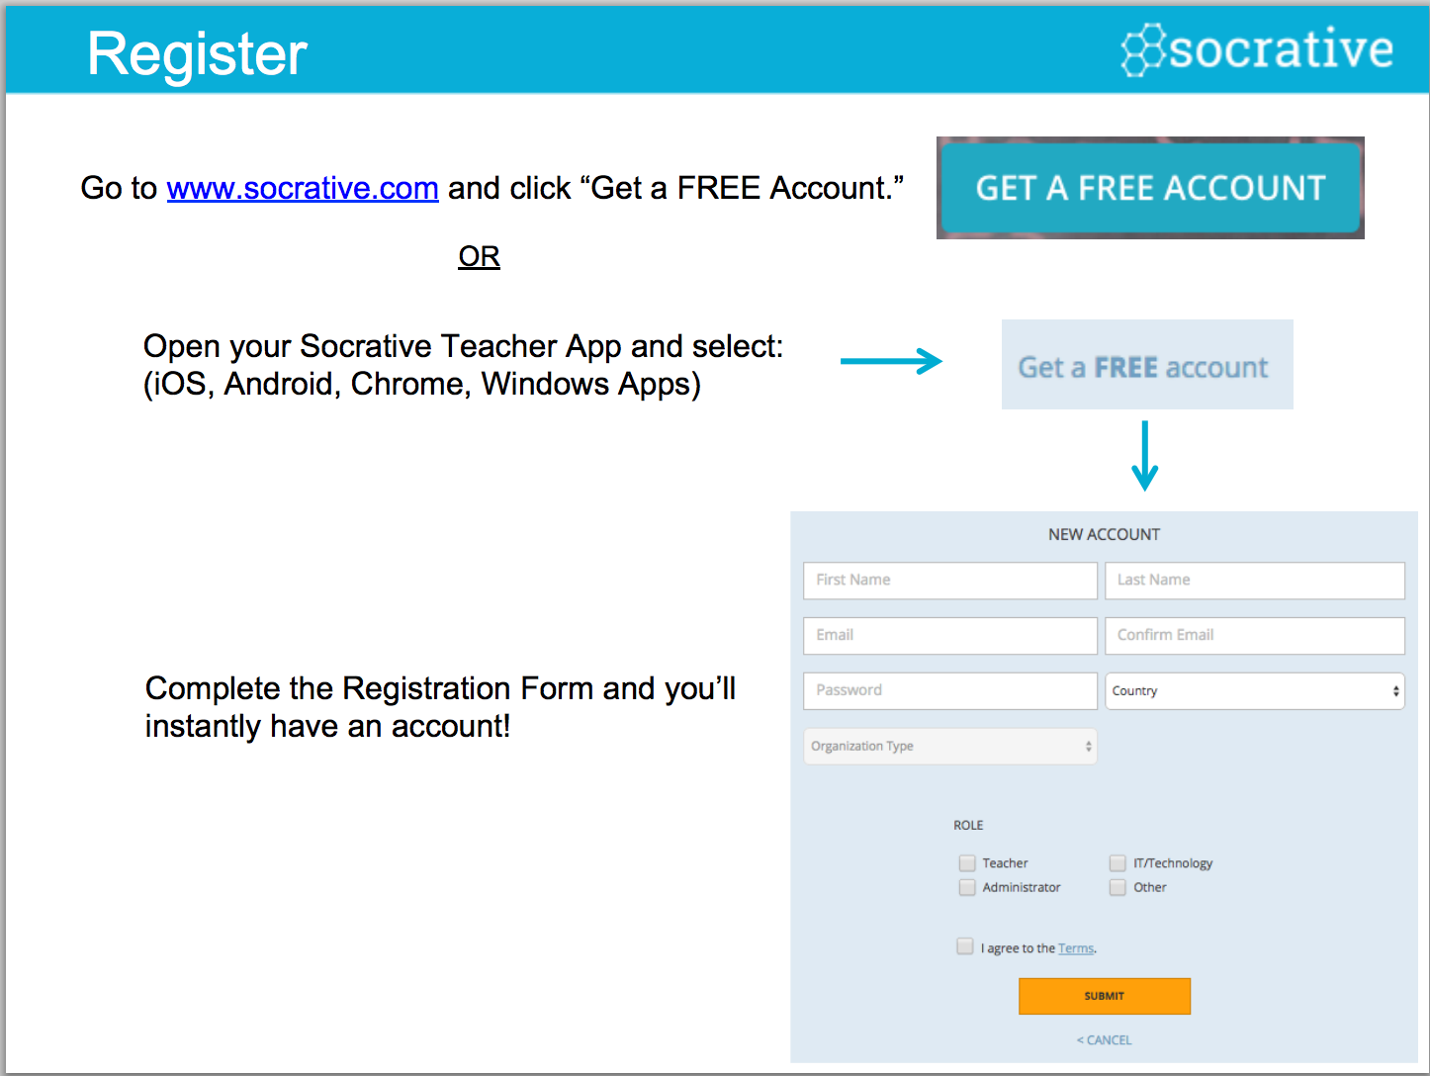

Slide 14
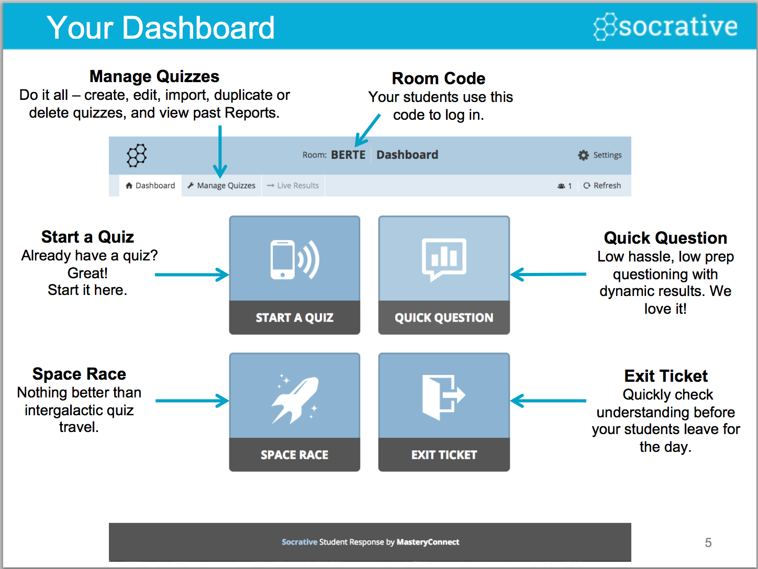

Slide 15
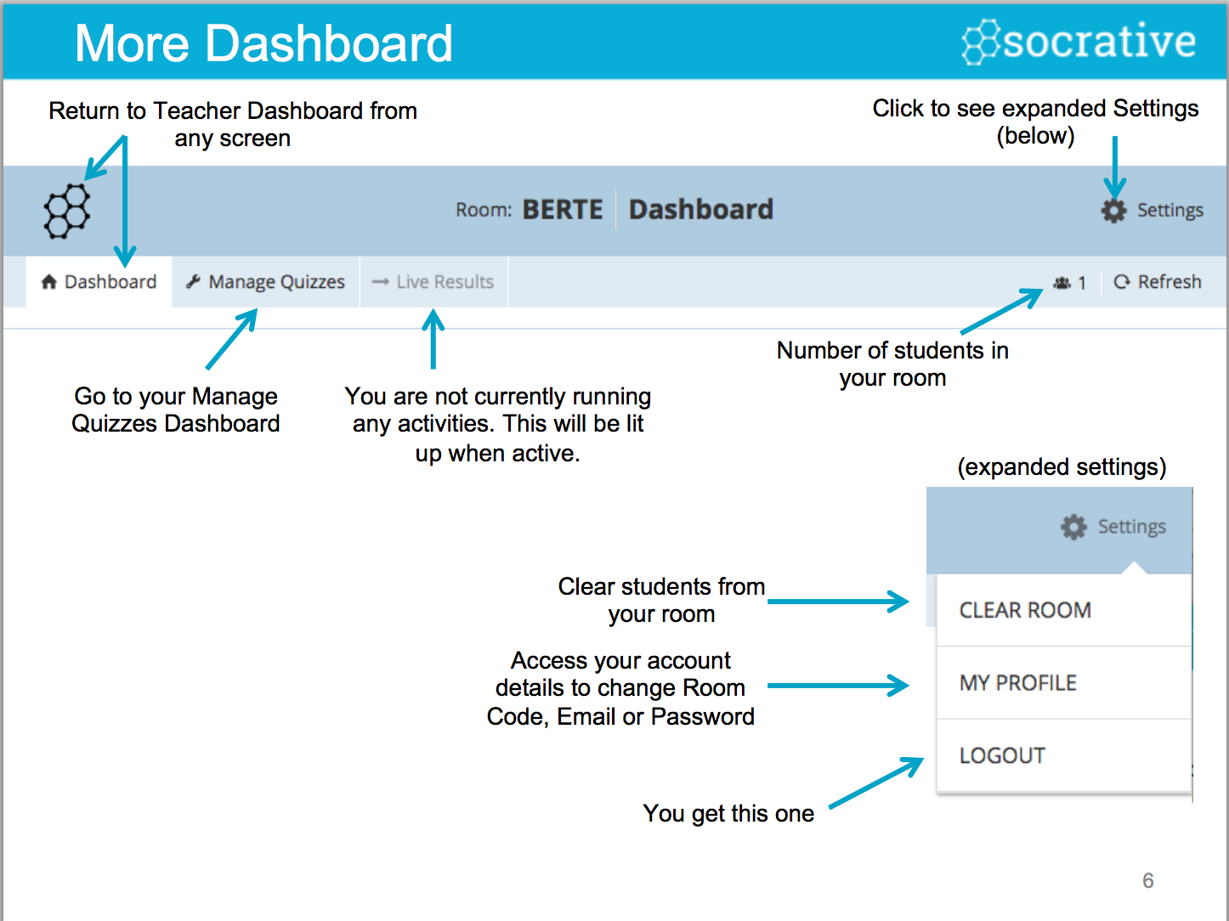

Slide 18
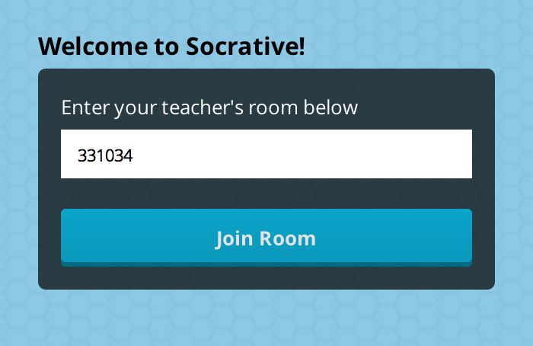
Let’s Take a Quiz!
Go to www.socrative.com
Select “Student Login”
Enter room number 331034

Slide 19
Kahoot
Game-based digital learning!
https://getkahoot.com/ (Create)
https://kahoot.it/#/ (Play)

Slide 20
Let’s play!

Slide 21
Plickers www.plickers.com
Plickers is a powerfully simple tool that lets teachers collect real-time formative assessment data without the need for student devices.
Demo- https://www.plickers.com/liveview

Slide 22
Self-Directed
Divergent Thinking
Depth of Knowledge
Hands-On
Performance Based
Differentiated
Multiple Resources
Authentic & Relevant
Checks for Understanding
Formative Assessments
Summative Assessments
Exit Tickets
Polling/Voting
Review
Notes:
These ideas for utilizing Socrative in class are relevant both for you as an instructor as well as for our teacher candidates when they teach in K-12 classrooms.

Slide 23
Tip #7: Track Progress with Digital Tools
“Vary your assessment methods through the use of mobile devices and podcasting, and you’ll gather even more information to inform instruction.”
“To give quieter students more of a voice in group discussions, try opening a private chat room just for your classroom.”
-Top Ten Tips for Assessing Project-Based Learning from Edutopia

Slide 24
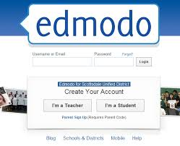
Formative Strategy- Online Discussions Edmodo: www.edmodo.com
Edmodo is a social media platform often described as “Facebook for the classroom”. The Edmodo network enables teachers to share content, distribute quizzes, assignments, and manage communication with students, colleagues, and parents.
Video Overview of Edmodo | Teachers Guide to Edmodo

Slide 25
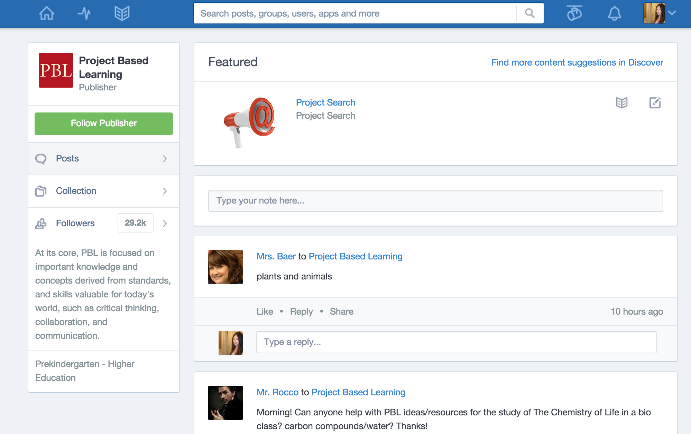
Using Edmodo to Assess PBL
20 Ways To Use Edmodo
Blog Post- How does Edmodo support PBL? by Dayna Laur (The Project and Edmodo as Support)
BIE Blog- Edmodo: The Classroom Hub for Project-Based Learning
Edmodo Project Based Learning Community

Slide 26
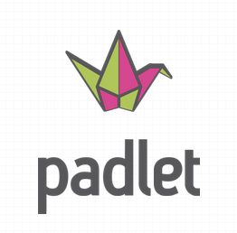
Formative Strategy- Discussion Boards Padlet: www.padlet.com
Padlet is a virtual wall that allows people to post any content (e.g. images, videos, documents, text) as a way to express ideas and/or communicate information. Padlet is a collaborative tool that enables users to work with anyone, from any device.

Slide 27
Using Padlet to Assess PBL
Padlet for Monitoring Progress
FETC 2015 Highlight: Technology Tools for Project-Based Learning and Student Collaboration
Create a project wall on which student can share to-do lists, project updates, and feedback
Reinventing Project-Based Learning by Suzie Boss (Chpt. 7, p. 147)
Quick reflection/snapshot of whole class
Example of whole class snapshot- http://padlet.com/spasquel/PBL
Padlet as Digital Product
Science Project- “How Does Mold Grow?”
Mutli-Media Poster

Slide 28
Formative Strategy- Digital Portfolio LiveBinders: www.livebinders.com
LiveBinders is a digital 3-ring binder that you can put virtually anything into; webpage, PDF, document, image, or video. Everything is organized by tab and you can even have sub-tabs within those tabs.

Slide 29
Using Livebinders to Assess PBL
Portfolios may contain a variety of items (called artifacts): rough drafts, graded assignments, papers, showcase pieces, critiques or summaries of reading, self reflection pieces, journal entries, peer responses, pictures/graphics, video, resources used,spreadsheets, etc.
Benefits of Using Portfolios in the Classroom
They document student growth, change, and risk taking"
They support dialogue between teachers and students
They, unlike tests, "supplement rather than take time away from instruction
They provide a convenient way to showcase work
They allow the instructor to be more of a coach
They provide a collection of multiple samples of student work over time enabling us to get a broader, more in-depth look at what students know and can do
They can, some proponents claim, cause students to increase critical thinking, self reflection, knowledge, participation, and responsibility for learning
(Sharp)

Slide 30
Using Livebinders to Assess PBL
Why Use E-Portfolios as an Assessment in Project-Based Learning?
“Because assessment is an integral part of the learning cycle, it is maintained both during and at the end of project-based learning (Solomon, 2003). Frank and Barzilai (2004) suggested that traditional assessment strategies will not be appropriate for gauging the goals of a project-based learning course. As an alternative assessment type, the portfolio method is widely used for project-based learning because its components are the reflections of students for different periods, improvement in their progress, and prospective goals.”
Journal of Research on Technology in Education

Slide 31
Using Livebinders to Assess PBL
20th Century Decades Project: Back_1950s_Freedom
This is a great project that gets the students to conduct research on different aspects of social culture – like music, literature, film, politics, etc.
What Would You Do? Project: Gossip
This is an example of a group project where 5 students are assigned to work together on a single project collaborating on a single binder. The project revolves around issues going on at their high school and they have to state the problem, come up with survey questions, conduct interviews, display results and analyze the results. Although the project is not yet complete, you can view how far the students have gone in their binder.
Mythology Yearbook: Class of 800-801 B.C.
Here is a student binder project (still in the works) looking at the role of mythology and interpreting it into today’s social figures and icons. This student is taking each mythological character and comparing it to a celebrity of today. The student has to understand the role and meaning for each mythological character and does that by interpreting social characters that we know of in today’s society.

Slide 32
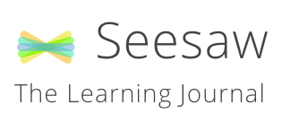
Formative Strategy- Digital Portfolio SeeSaw: http://web.seesaw.me
Seesaw is a student-driven digital portfolio that empowers students of all ages to independently document and share what they are learning at school. ∙ Students can use photos, videos, drawings, text notes, links or PDFs to show what they know.

Slide 33
Using SeeSaw to Assess PLB

Slide 34
Using SeeSaw to Assess PLB

Slide 35
Using SeeSaw to Assess PLB

Slide 36
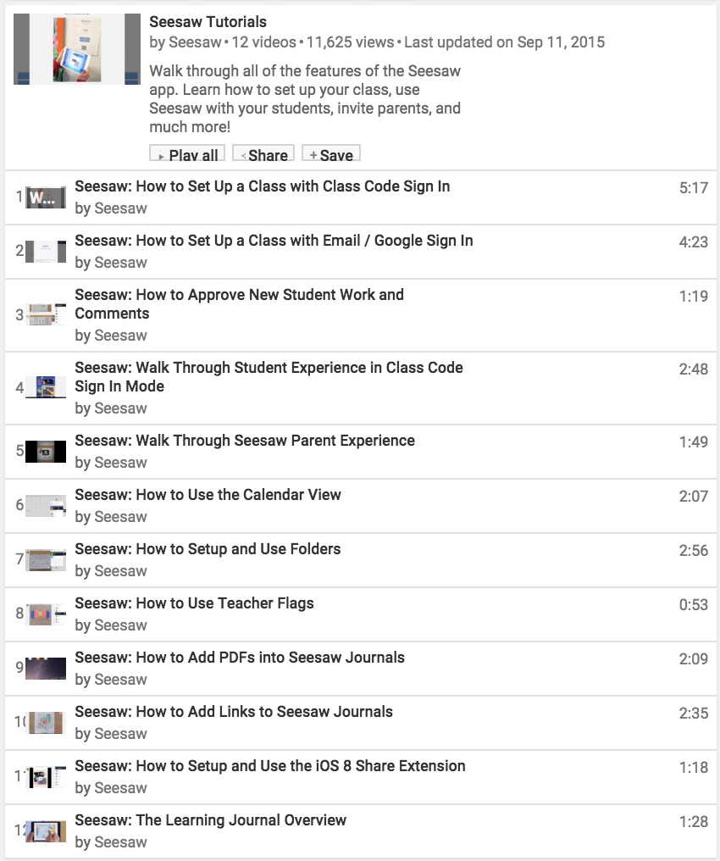
Using SeeSaw to Assess PLB
Seesaw App Tutorials by SeeSaw (YouTube)

Slide 37
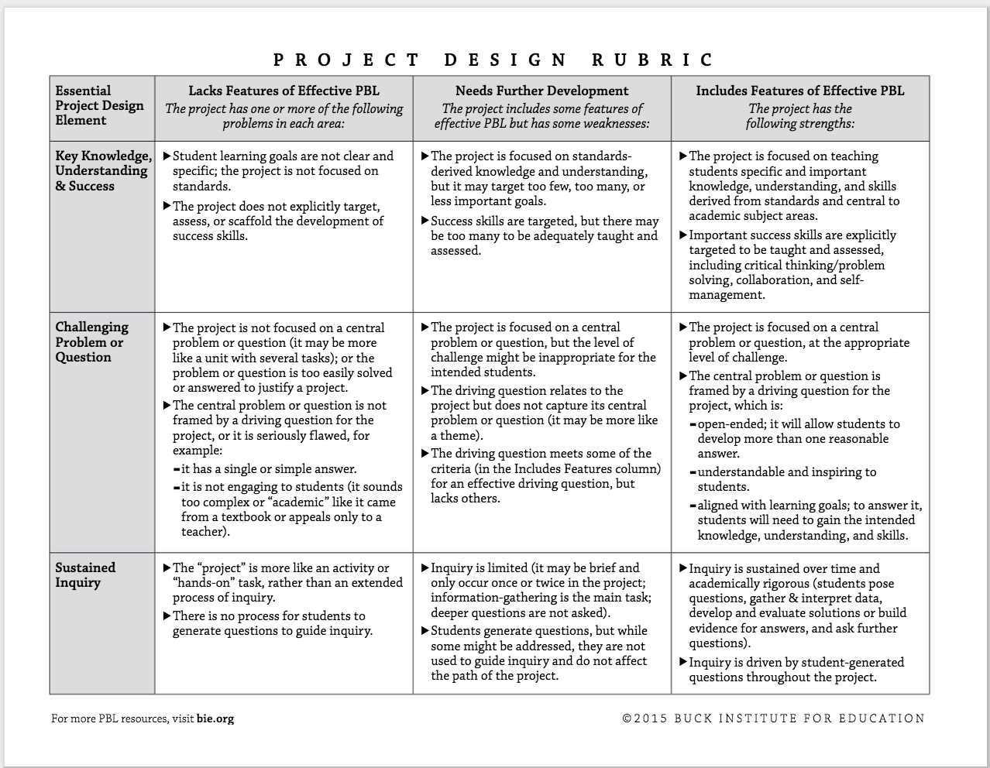
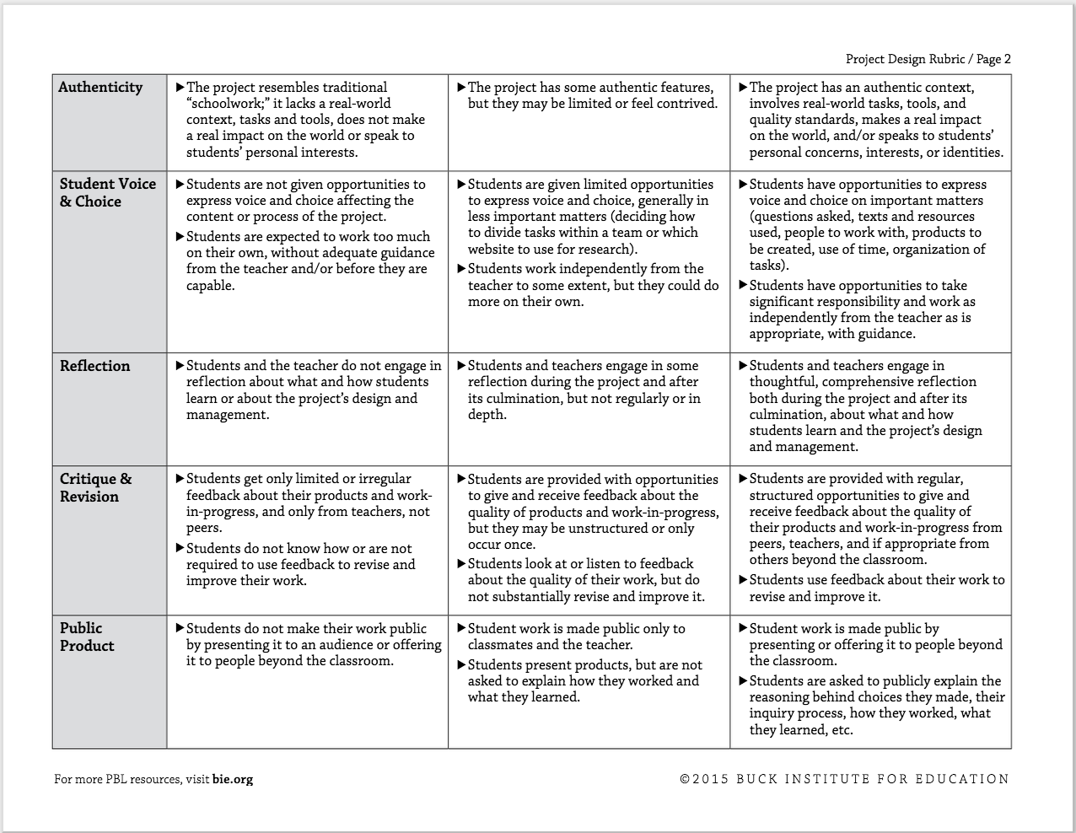
PBL Rubrics
Buck Institute for Education (BIE) http://bie.org/objects/cat/rubrics

Slide 38
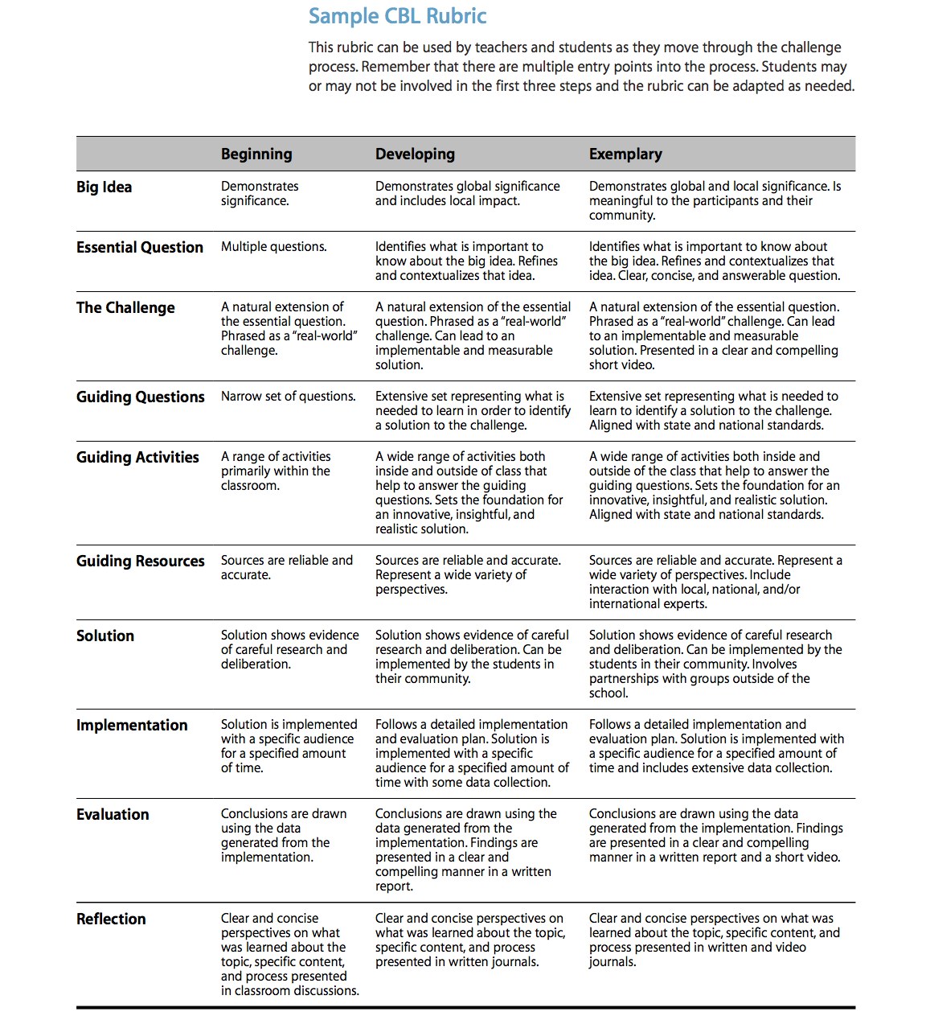
PBL Rubrics
Challenge-Based Learning (CBL) Classroom http://images.apple.com/education/docs/CBL_Classroom_Guide_Jan_2011.pdf
p. 25

Slide 39
Creating Rubrics http://rubistar.4teachers.org/index.php

Slide 40
Additional Resources
Practical PBL: The Ongoing Challenges of Assessment by Katie Piper (Edutopia contributor)

Slide 41
References
Edutopia. (2011). Top ten tips for assessing project-based learning. Retrieved from http://www.edutopia.org/pdfs/guides/edutopia-10tips-assessing-project-based-learning.pdf
Gülbahar, Y. & Tinmaz, H.. (2006). Implementing Project-Based Learning And E-Portfolio Assessment In an Undergraduate Course. Journal of Research on Technology in Education. Retreived from http://files.eric.ed.gov/fulltext/EJ728907.pdf
Sharp, J. E. (n.d.). Using Porfolios in the Classroom. Nashville, TN: Vanderbilt University. Retrieved from http://citeseerx.ist.psu.edu/viewdoc/download?doi=10.1.1.197.5200&rep=rep1&type=pdf

