Slide 1

Teach Multi-Level Literacy Skills Through Multi-Media
Ali Conant, EdD, NBCT
2015 AzTEA Digital LEarning Showcase
P3: Problems, Projects & Possibilities
10/17/15
5th Grade/Coyote Springs Elementary
K-6 ELA Curriculum Coordinator: HUSD
drconantteacher@aol.com

Slide 2
Target
By the end of our time together, you will have a toolbox of ideas to utilize with your students to enhance their daily ELA motivation and fluency using multi-level literacy strategies.
Draw on information from multiple print or digital sources, demonstrating the ability to locate an answer to a question quickly or to solve a problem efficiently. (5.RI.7)

Slide 3
Keeping Track of Our Learning
Let’s create a Roundtable Discussion Organizer…
Categories:
Pictures
Writing Inspired by Videos
Music
Commercials/Campaigns

Slide 4
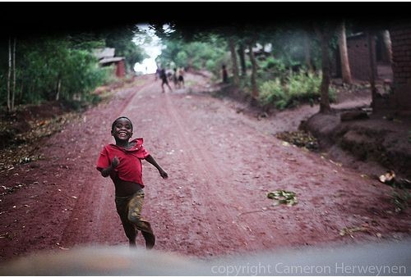
Pictures Are Worth A Thousand Words

Slide 5
Essential Question:
Is freedom really free?

Slide 6
On Your Tables You Will Find…
A picture taped to a piece of poster paper.
Questions on the paper.
As a team, please jot down your answers to each of the questions.
You have 5 minutes….GO!

Slide 7
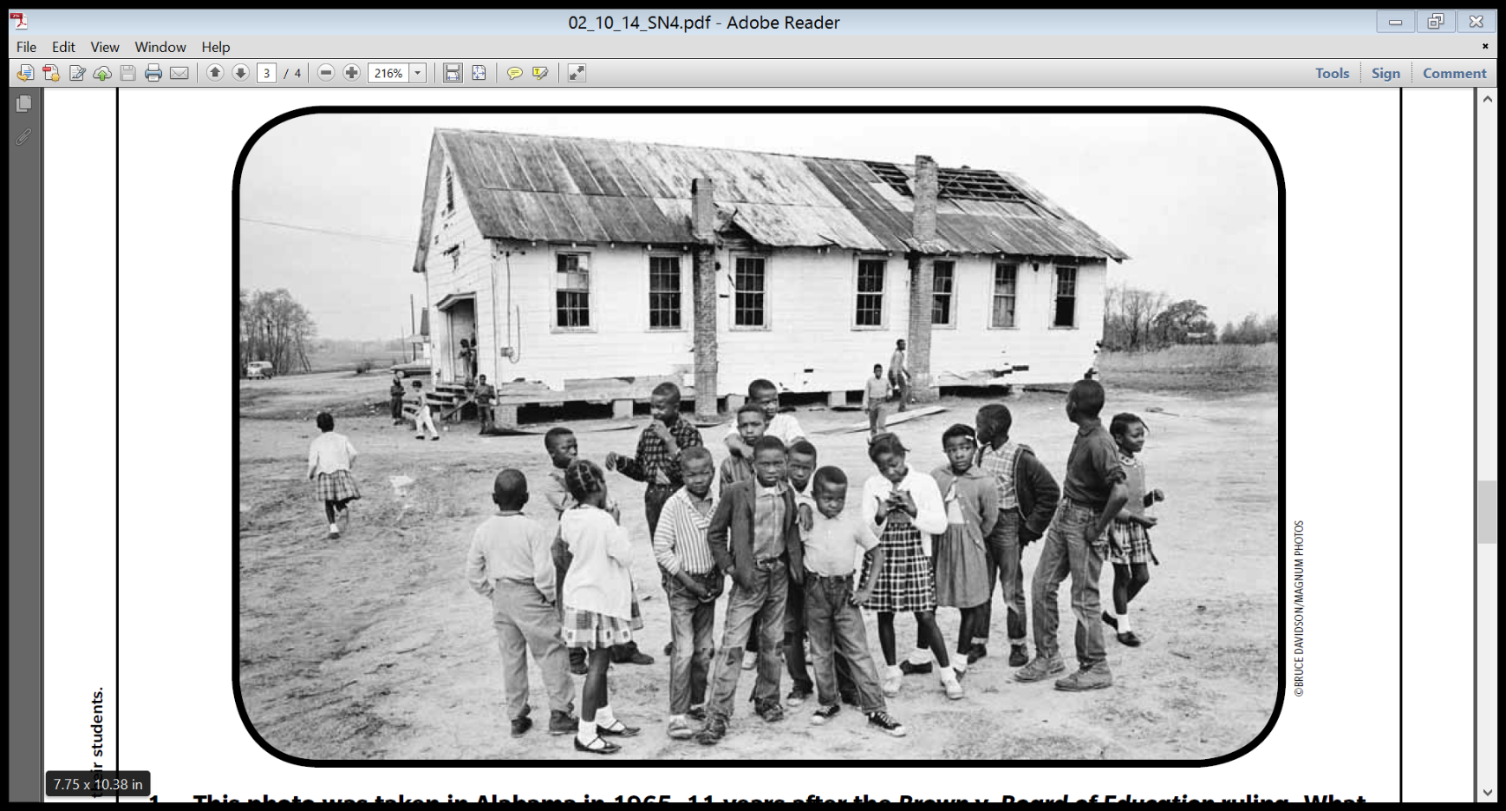
How does the setting of this picture impact your overall thoughts of this picture?

Slide 8

What happened just BEFORE this picture was taken?

Slide 9
What happened just AFTER this picture was taken?

Slide 10
How does this picture make you feel? Why?

Slide 11
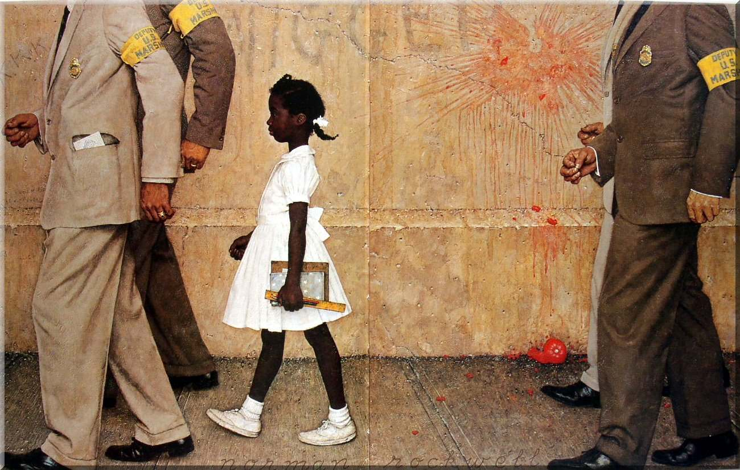
Where do you think the girl is going?

Slide 12
What do you think are the circumstances?

Slide 13
What do you think the girl is thinking?

Slide 14
What do you think the girl’s relationship is to the men?

Slide 15

What do you think the relationship is between these two pictures? Why?

Slide 16

This photo was taken in Alabama in 1965, 11 years after the Brown vs. Board of Education ruling. What might the photo tell you about how long it took for the ruling to affect segregation in the South?

Slide 17

What does the photo suggest about the quality of education for black children in the mid-1900’s?

Slide 18

Compare the school in the photo with your own.
Be as descriptive as possible.

Slide 19
Essential Question
Is freedom really free?
Reflection….
  On your Roundtable Organizer write down a reflection of using pictures to influence critical thinking.

Slide 20
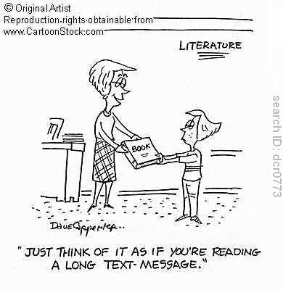

Slide 21
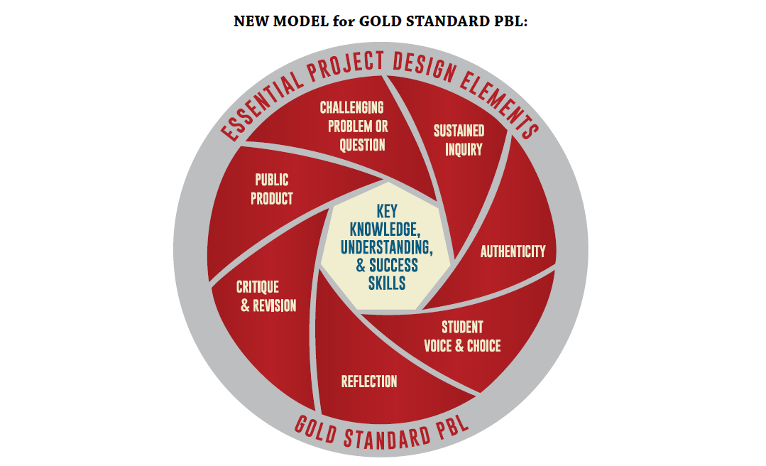
Skills
PBL is a teaching method in which students gain knowledge and skills by working to investigate and respond to an engaging and complex question, problem, or challenge.
Buck Institute: 2015 http://bie.org/

Slide 22

Tune into Writing
“Music is a world within itself with a language we all understand…”
  -Stevie Wonder
  -Sir Duke, 1976

Slide 23

Making Connections
Why do students love music?
Rhyme
Lyrics and words
Rhythm and beats
Feelings
Dancing and moving
Memories
Friends and fun

Slide 24

Transformation
“Music can transform classrooms into positive learning environments where children thrive academically, socially, and emotionally.” (Paquette & Rieg, 2008)

Slide 25
Brain Power
Memory appears to be enhanced by music because it involves both sides of the brain. When engaged with song, the left brain (language/math) processes the lyrics while the right brain (rhythm, rhyme, emotion) processes the music…(Kimball & Connor)

Slide 26
Let’s Play
Listen to an ABC song by Carol King, Alligators All Around.
In your WRITERS JOURNALS jot down any imagery and memorable descriptions the song may trigger.

Slide 27
Activity 1
With your group, create your own alphabet song, poem or book using 2-3 word descriptions: ex. Alligators all around, doing dishes, quite quarrelsome
Alliteration
ELL may make books in native language to teach others their alphabet.

Slide 28
A Place of My Own Listen
Listen to Up on the Roof, by James Taylor
In your WRITERS JOURNAL, jot down descriptions or reasons why this place is a getaway for the singer.
Where do you like to go or what do you like to do when you feel the need to get away? Why do you like this place or activity?(pictures or words)

Slide 29

Ragged Old Flag: A Poem
1. Why did the author write this?
2. In one sentence, what was this poem about?
3. What do you like about this poem?
4. What connection can you make to another piece of text from this writing? (T-T)
5. What personal connection can you make to this writing? (T-S)
Ragged Old Flag
6. Did the music change the meaning of the poem for you? If so, how?

Slide 30
Symbolism and Personification
Music and History
Listen to Ragged Old Flag, by Johnny Cash.
In your WRITERS JOURNAL:
Reflect on how this song made you feel?
Choose another American symbol and personify it in a poem.
*Write your own poem or song about the American Flag and what it means to you. If you are from another country, write about your flag.
*Choose a person, place or event from the song and research it.

Slide 31

Sound tracking Your Life
Timeline your life. Try to select at least 5-10 specific event or times in your life that are significant to telling the story of you.
Find parallel events in the American or World History.
Look up the Billboard Top 20 for that week or year.

Slide 32

Sound Tracking Your Life
Reflect on the music of the time, and other music that reminds you of those times.
Select a “soundtrack” for your life and make a playlist.
Write “linear notes” that include a brief written summary of the significance of the song and its relationship to the event.
Create a Movie using parts of your songs, liner notes, and pictures that represent your thoughts/feelings attached to the songs.
Create a CD and that represents the soundtrack of your life. Create an original “cover” for your CD and include your liner notes.

Slide 33
Resources
https://www.commonsensemedia.org/music-lists
http://www.azlyrics.com/

Slide 34
Reflection….
  On your Roundtable Organizer write down a reflection of using music to influence critical thinking.

Slide 35
Pass The Story
1. Please choose a colored pencil to write with. Ideally, everyone at your table will have a different color.
2. You will be shown a “video” in segments.
3. After each segment, you will be given a small amount of time to write what you “see.”
4. Then, you will be asked to “pass your story” to the person to your right.
5. You will be given a few moments to read your teammates writing.
6. Then, you will be shown a “continuing” video segment…and the process will repeat itself.

Slide 36
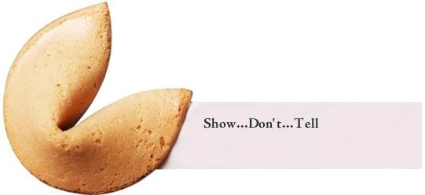
Pass The Story
Ormie

Slide 37
Now….
Share the “story” you have with your teammates.
Discuss the similarities in each story?
Discuss the differences in each story?
How can you use this process in your class?

Slide 38
Reflection….
  On your Roundtable Organizer write down a reflection of using videos to influence writing motivation.

Slide 39

Media Response
Television commercials are designed to persuade. Have you ever watched a commercial on television and wondered how such a silly or strange or obvious image could possibly be effective?
How can you use this media to teach higher level thinking skills with your students?

Slide 40
As you watch….be thinking about…
1. What is it about this commercial that attracts or repels you?
2. What is the advertiser trying to get you to do?
3. What are some images or techniques in this commercial that you feel a connection with? Does this increase or decrease your interest in the product?
4. What was the “target” group for this commercial?
5. If given the opportunity, how would you change this commercial? Why?

Slide 41
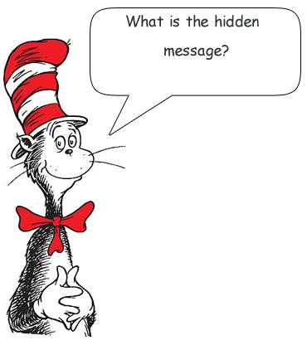
Commercial

Slide 42
As you watch….be thinking about…
1. What is it about this commercial that attracts or repels you?
2. What is the advertiser trying to get you to do?
3. What are some images or techniques in this commercial that you feel a connection with? Does this increase or decrease your interest in the product?
4. What was the “target” group for this commercial?
5. If given the opportunity, how would you change this commercial? Why?

Slide 43
Let’s Take A Look At Campaigns
https://www.youtube.com/watch?v=MUCNY0b6hN4
https://www.youtube.com/watch?v=dDTBnsqxZ3k
https://www.youtube.com/watch?v=iFf0lps3NhQ
https://www.youtube.com/watch?v=UPy7RnHwvmA

Slide 44
Reflection….
  On your Roundtable Organizer write down a reflection of using commericals/campaigns to influence critical thinking.

Slide 45
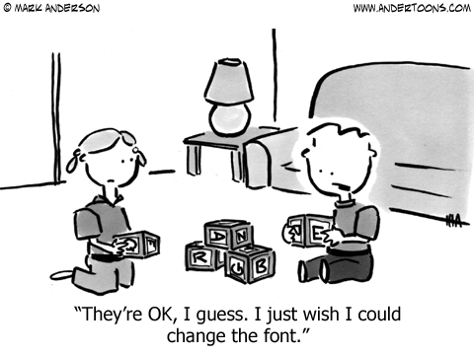

Slide 46

Parting thought….
Personal Connections = Successful Students!

Slide 47
Reflection: 3-2-1
In the center of your organizer:
*Three (3) things you are taking away from this presentation.
*Two (2) questions you have.
*One (1) personal connection.
Thank you for your time
And energy!

Slide 48
PBL Resources
http://bie.org/
https://ldc.org/
http://pblu.org/

