Slide 1
SchoolWide STEM Implementation
Kamren Taravati, m.edl
Back Channel: www.todaysmeet.com/fallazteakt

Slide 2
Why school wide?

Slide 3
Earning Power

Slide 4
The Youtube generation
Michele Phan – Make up Artist Videos - $1 Million
WhiteBoy7thSt – Call of Duty Videos - $1.7 Million
Ray Williams Johnson – Funny Videos - $4.1 Million
PewDiePie – Minecraft Videos - $6.1 Million
The next time your student asks to be a YouTuber, encourage it!

Slide 5
Where are the jobs?

Slide 6
Why SchoolWide?
“In a new report, GSE researchers identify secrets to successful technology implementation, particularly with students at risk of dropping out.”

Slide 7
Why Schoolwide?
“The inability to code is one of the largest Social Justice issues of our time.”
- Kevin Brookhouser, GAFE Summit, Riverside, CA

Slide 8
Why SchoolWide?
Don’t Believe…
“Low-income teens and students of color are noticeably less likely to own computers and use the internet than their peers. Because of their students’ lack of access, teachers in high-poverty schools were more than twice likely (56 percent versus 21 percent) to say that their students’ lack of access to technology was a challenge in their classrooms.”

Slide 9
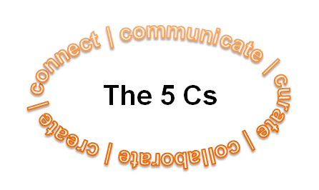
What is Stem?
Science
Technology
Engineering
Math
Art

Slide 10
The 5Cs!
Turn to a shoulder partner, and talk about what the 5Cs are and why might they be essential to 21st century learning!

Slide 11
Our Journey with the 5cs

Slide 12
Who are we?
Small Charter serving 100 students in Urban Setting
Grades 6 – 8
94 percent of students qualify for Free/Reduced Lunch
92 percent of students are identified as Hispanic, Native American, or African American
35 percent of students live in a single parent household
History of academic underperformance
History of adjudication

Slide 13
Why the focus on 5cs?

Slide 14
Why the focus on the 5cs?
Engaged Students = Increase in Student Achievement

Slide 15
Our Plan
Identify a specific technology that each teacher would use
Attach to a SMART goal
Attach to an increase in reading or mathematics
Identify criteria for responsible parties, rubrics, timeline, how students will communicate etc.
Place in one central document
Celebrate student work

Slide 16
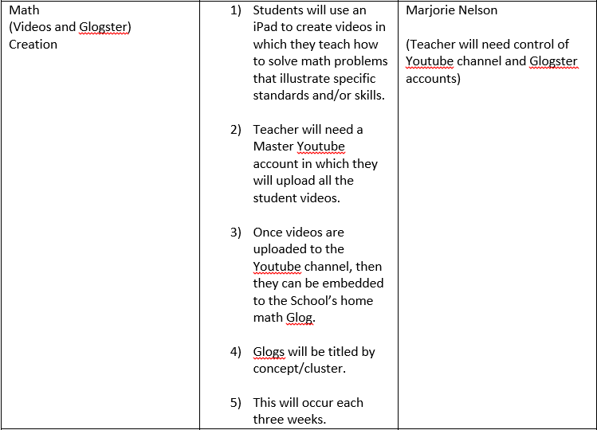

Slide 17
Student artifact

Slide 18
Stem offerings at Pima partnership academy
Digital Music
iPad Math Movies
Robotics
Schoology for Flipped Classroom
Story Board
Facebook

Slide 19
Student video: sy 2014-2015
STEM in Play

Slide 20
*The Results
Reading Scores – 56% Growth
Math Scores – 70% Growth
Science Growth – 78% growth

Slide 21
SY 2015-2016
Digital Music
iPad Math Movies
Robotics
Schoology for Flipped Classroom
Story Board
Hiring of STEM Teacher
Code Academy
Web Design
Facebook
Systems Thinking

Slide 22
DIY – Before you Start
Logistics:
Get the money
Write a grant: AzTEA, SEED, Private – Grant Alert, Grant Siren
Look to Instructional Improvement, M/O (General Fund), or Work with Program Specialist(s) at ADE
Create the infrastructure – Networks, Servers, Connectivity (‘The Milk Shake Effect’)
Get the hardware – iPads, Netbooks, Surface Pro, Chromebooks
Create the culture

Slide 23
DIY – What’s already working?

Slide 24
Who are your shinning stars?
Turn to your shoulder partner…Who can you get on your side to implement a Schoolwide STEM Plan? Who will take the ball and run with it? What roadblocks will you have (people, things, etc.)?

Slide 25
DIY – Multiyear Planning/BD
Committee Work
PLC Work
Teacher Work

Slide 26
Implement, Celebrate, and Advertise

Slide 27
Questions and Contact
Kamren Taravati, M.EDL
ktaravati@gmail.com
@MrTaravati
LinkedIn

